Slide 1
Chapter 0 Welcome to the Software Construction Course
CCSW 325 (Software Construction)
Notes:
Last Update: 22/8/2019
Version 1.0

Slide 2

Course Description
Despite the rapid advances in software development practices, we still produce software that are buggy, late, over budget, and many fail to satisfy the needs of their users.

Slide 3
Course Description
This course introduces the students to the modern technologies and concepts associated with constructing software.
The experiences and knowledge subareas for software construction like software construction fundamentals and practical considerations to help students to create higher-quality software.
The experiences and knowledge to the appropriate tuning and refactoring strategies & techniques to resolve design problems in code.
The experiences and knowledge subareas for software maintenance

Slide 4
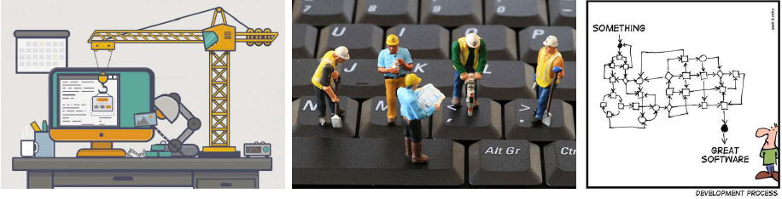
Course Objectives
The objectives of this course are:
Introduce the students to the fundamental principles and techniques of software construction.
Equip the students with the skills to manage software construction towards maintainable software that is easy to maintain in future.

Slide 5
Course Learning Objectives (CLOs)
The CCSW325 will enable you to:
[CLO 1.1]: Introduce software construction fundamentals.
[CLO 1.2]: Introduce some topics related to software maintenance.
[CLO 2.1]: Apply advance principles and best practice to create clean and high-quality code.
[CLO 2.2]: Apply code tuning strategies and techniques to write efficient code.
[CLO 2.3]: Apply code refactoring methods to reformulate the code into a more understandable and maintainable form.

Slide 6
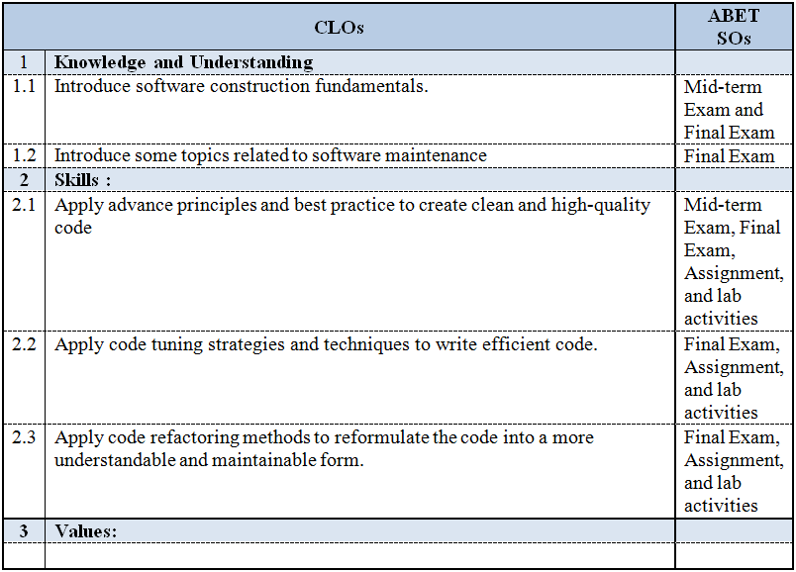
Assessment

Slide 7
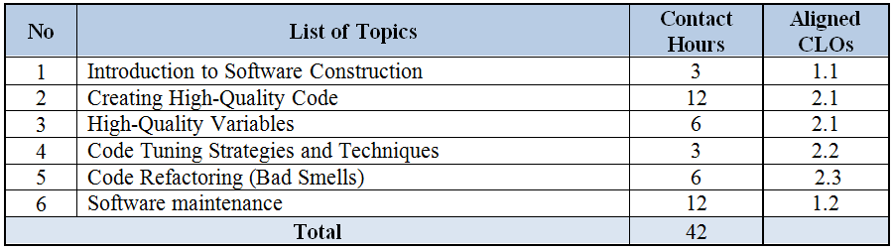
Course Content

Slide 8
Grading
# | Assessment Task | Week Due | % of Total
1 | Mid-term | 11 | 20%
2 | Term Project | - | 20%
3 | Lab Activities | - | 10%
4 | Quizzes | Random | 10%
5 | Final Exam | 18 | 40%
NOTE: This is a tentative outline for the course and may be updated based on instructor discretion.

Slide 9
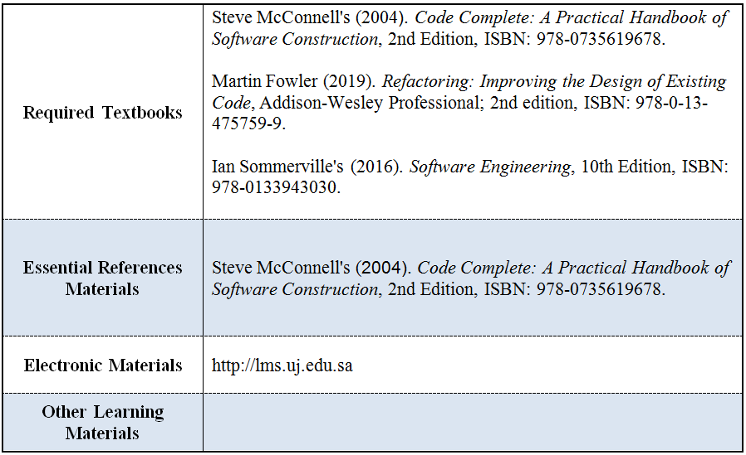
Learning Resources

Slide 10
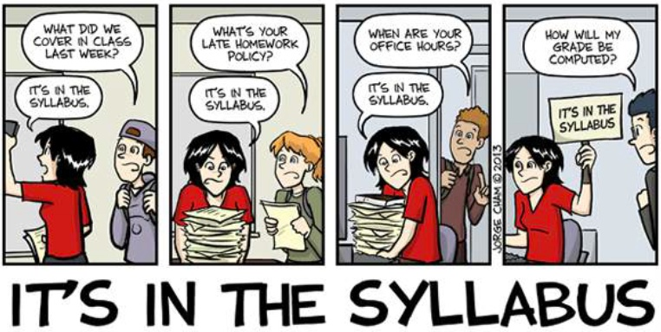
Please Note ..
Homework and project deliverables will be due at the specified time on the specified day, in the specified format.
Late quizzes, homework assignments, lab activities, and project deliverables WILL NOT BE ACCEPTED.

Slide 11

Any questions? ​
Please feel free to raise your hands and ask.

